Slide 1
Logical Architecture and UML Package Diagrams

Slide 2
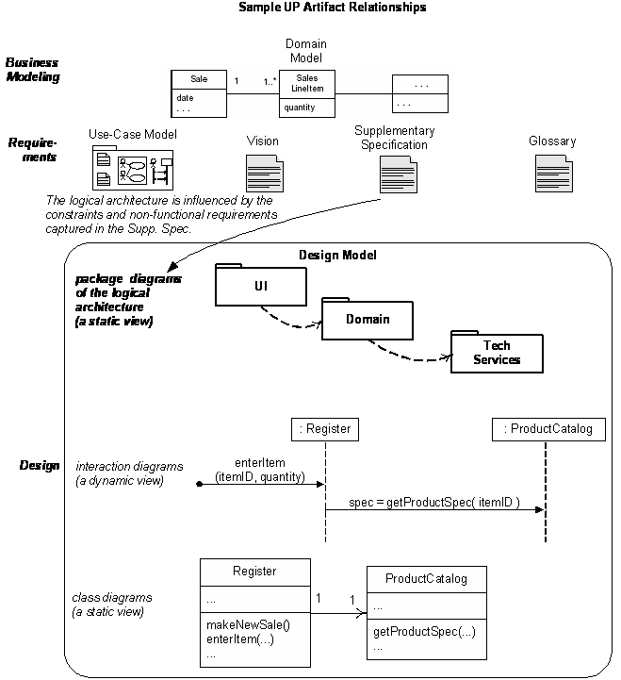

Slide 3
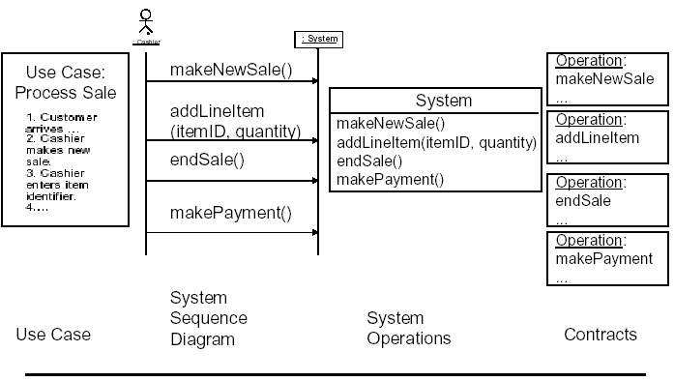

Slide 4

Logical Architecture
The logical architecture is the large-scale organization of the classes into packages (namespaces), subsystems, and layers.
No decision about how they’re deployed

Slide 5
Definition
Software Architecture:
Decisions about the organization of a software system
Selection of structural elements and their interfaces, along with their behavior.
Organization of elements into progressively larger systems
large scale-the Big Ideas in the forces, organization, styles, patterns, responsibilities, collaborations, connections and motivations of a system and major subsystems.
Notes:
There are various forms of it. But the common theme is that it has to do with

Slide 6
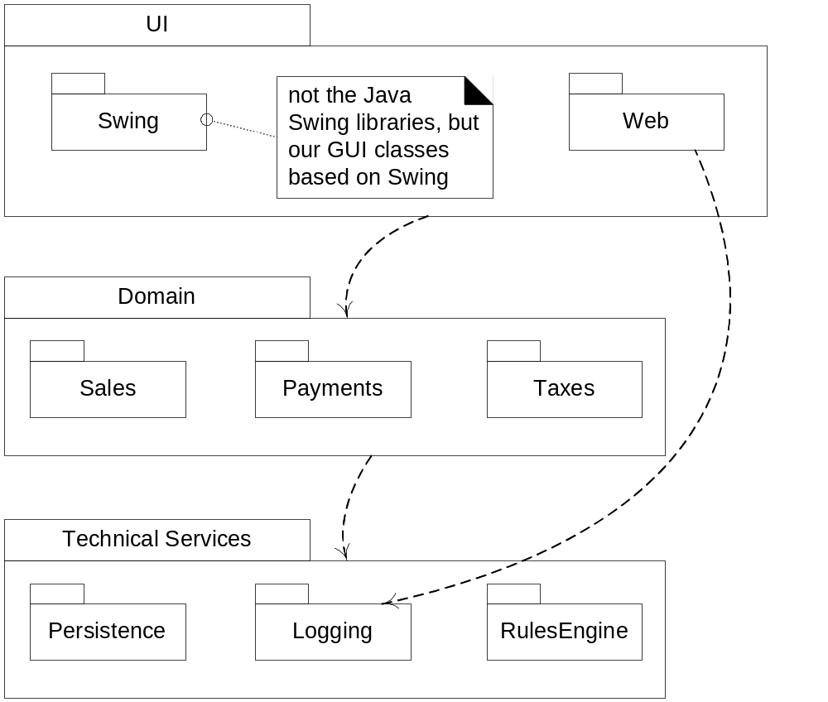
Notes:
Fig. 13.2

Slide 7
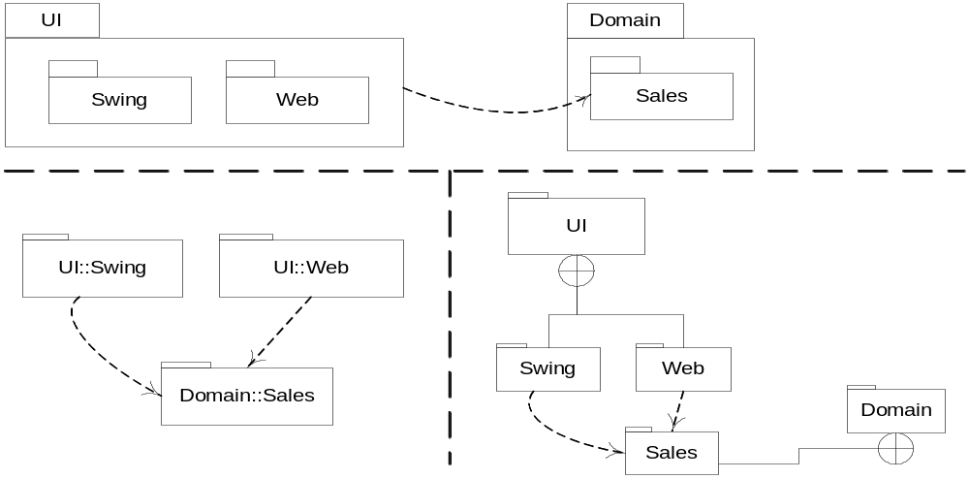
Fig. 13.3
Notes:
右下角图 Membership notation: UI包由Swing和Web包组成， Domain包包含Sale包

Slide 8

Definition
Architectural investigation: involves functional and non-functional requirements that have impact on system design.
  Some of these are: Market trends, performance, cost and points of evolution.
Architectural Design: is the resolution of these requirements in the design of software.

Slide 9
Architectural Dimension and Views in UP
The common dimensions are:
  The logical architecture, describes the system in terms of its conceptual organization in layers, packages, classes, interfaces and subsystems.
  The deployment architecture, describes the system in terms of the allocation of process to processing unit and network configurations.

Slide 10
What is a layer?
“A layer is a coarse grained grouping of classes packages or subsystems that has cohesive responsibility for a major aspect of the system.”
Higher layers call services in lower layers but not the other way around.
Strict Layered
Relaxed Layered

Slide 11
Architectural Patterns and Pattern Categories
Architectural patterns: Relates to large-scale design and typically applied during the early iterations(in elaboration phase).
Design patterns: Relates to small and medium-scale design of objects and frameworks.

Slide 12
Architectural Pattern:Layers
Idea behind Layer patterns:
  Organize the large-scale logical structure of a system into discrete layers of distinct, related responsibilities with a clean, cohesive separation of concerns such that the “lower” layers are low-level and general services, and the higher layers are more application specific.
  Collaboration and coupling is from higher to lower layers.

Slide 13
Inter-Layer and Inter-Package Coupling
It is informative to include a diagram in the logical view that shows the coupling between the layers and packages.
Following figure shows the coupling.

Slide 14
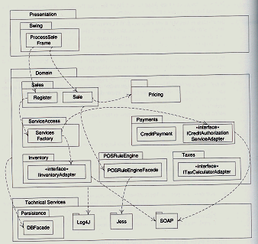
Partial coupling between Packages

Slide 15
Typical Layers
User interface
Application logic and domain objects
Technical services – subsystems that support low-level functions, such as interfacing with a database, external hardware, or error logging.
In strict layering, a layer only calls upon services in the layer directly below it.

Slide 16
Design with Layers
Organize the logical structure into distinct layers with related responsibilities, clean separation from lower layers.
Higher layers are more application-specific
CS6359 Fall 2012 John Cole

Slide 17
Layers…
Address several problems:
  Source code changes ripple through the entire system
  Application logic can’t be reused because it is intertwined with the UI
  General business logic is intertwined with application-specific logic
  High coupling across different areas
CS6359 Fall 2012 John Cole

Slide 18
Another view of Layers
GUI
Application: handles presentation layer requests, workflow, session state, window/page transitions
Domain: app layer requests, domain rules, domain services
Business infrastructure
Tech services
Foundation: threads, math, network I/O
CS6359 Fall 2012 John Cole

Slide 19
Guideline
Don’t show external resources as the bottom layer.
CS6359 Fall 2012 John Cole

Slide 20
Tiers, Layers, Partitions
Tiers were originally logical layers, but now the term has come to mean physical nodes.
Service Oriented Architecture
Layers are vertical slices, while partitions are horizontal divisions of subsystems within a layer. E. g. tech services may contain Security and Reporting
CS6359 Fall 2012 John Cole

Slide 21
Inter-Layer and Inter-Package Interaction
Emphasizes the dynamics of how objects across the layers connect and communicate.
The interaction diagram focuses on the logical view and on the collaborations between the layers and package boundaries.

Slide 22
Package Diagrams
UML Package Diagrams are often used to show the contents of components, which are often packages in the Java sense.
Each package represents a namespace.
Packages, as components, can be nested inside other packages.

Slide 23
Package Diagram
UI
Domain
Swing
Web
Sales

Slide 24
Logical vs. Process and Deployment of Architecture
Architectural Layers are a logical view of the architecture
They are not a deployment view of elements to process.
Depending on platform, all layers could be deployed within the same process on same node.
Or across many computers.

Slide 25
Terminology:Tier, Layers, and Partitions
Tier relates to physical processing node or clusters of node, such as “client tier”.
Layers of an architecture represent the vertical slices
Partitions represents a horizontal division of relatively parallel subsystems of a layer.

Slide 26
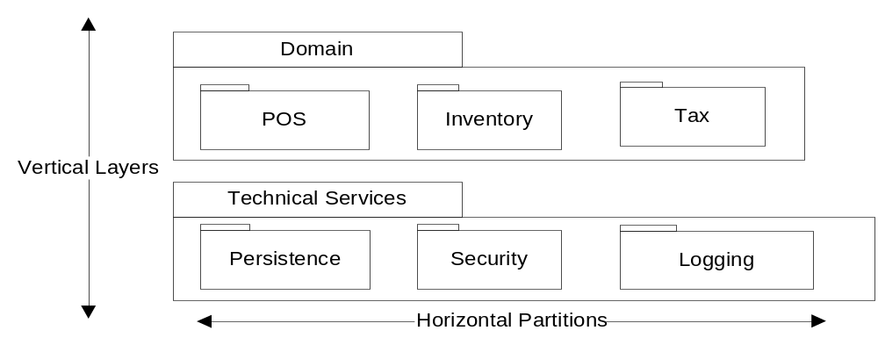
Fig. 13.6 Layers and Partitions
Copyright © 2004 Glenn L. Ray
(From Larman 2004)

Slide 27
How do we design application logic with objects?
We could create one class and put all logic in it, but that violates the whole spirit of object orientation.
We create software objects with names drawn from the real world, and assign application logic responsibilities to them.
It takes a lot of skill and experience to do a good job of choosing objects and assigning responsibilities.

Slide 28
Domain Layer and Domain Model
These are not the same thing. Domain model shows the real world, while the Domain layer shows the software architecture.
But the Domain model inspires the Domain layer, and is the source of many of the concept, especially class names.
Do not confuse the problem with the solution.

Slide 29
Connections
SSDs illustrate system operations but hide the UI layer. Yet the UI capture the operation requests
The UI layer delegates the requests to the domain layer
Thus messages from the UI to the domain are the messages in the SSDs, such as enterItem.
CS6359 Fall 2012 John Cole

Slide 30
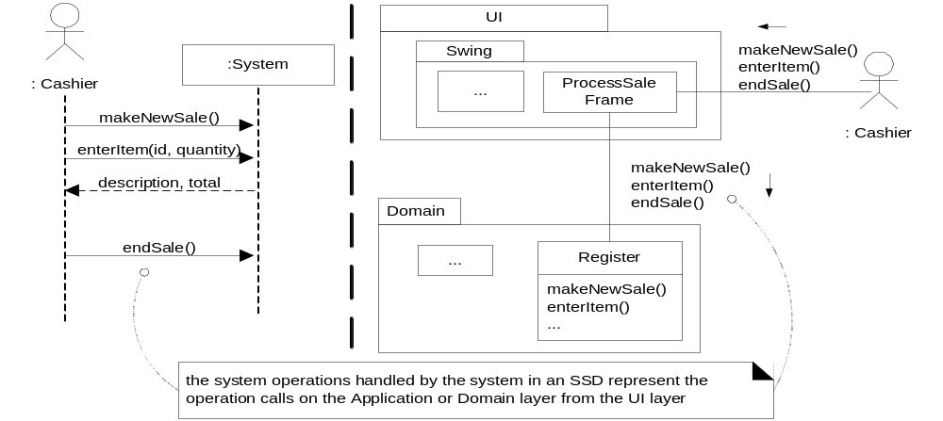
Fig. 13.8

Slide 31
Information Systems
In IS layered architecture was known as three-tier architecture.
A three-tier architecture has interface, Application logic and a storage.
The singular quality of 3-tier architecture is:
  Separation of the application logic into distinct logical middle tier of software.
  The interface tier is relatively free of application processing.

Slide 32
Information Systems(cont..)
The middle tier communicates with the back-end storage layer.
The following is an example of 3-tier architecture.

Slide 33
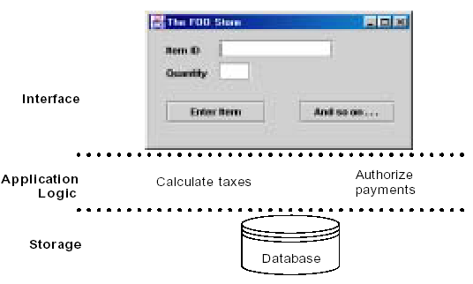
Example:

Slide 34
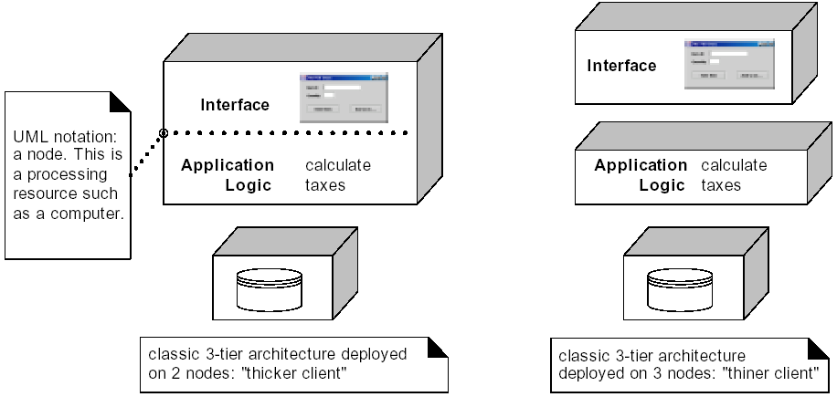
Notes:
左边: 传统的三层架构部署在2个节点上
左边: 传统的三层架构部署在3个节点上

Slide 35
Two-tier Design
In this design, the application logic is placed within window definitions, which read and writes directly to database.
There is no middle tier that separates out the application logic.

Slide 36
The Model-View Separation
Principle
The principle states that model(domain) objects should not have direct knowledge of view(presentation) objects.
Furthermore, the domain classes should encapsulate the information and behavior related to application logic.

Slide 37
Model-View
Don’t connect non-UI objects directly to UI objects. Don’t let a Sale object reference directly a Jframe
Don’t put application logic, such as tax calculation, in a UI object’s methods. UI objects should only initialize the elements, receive UI events, and delegate requests for application logic to non-UI objects
CS6359 Fall 2012 John Cole

Slide 38
Need for Model-View separation
To support cohesive model definitions that focus on the domain process, rather than on interfaces.
To allow separate development of the model and user interface layers.
To minimize the impact of requirements changes in the interface upon the domain layer.
To allow new views to be easily connected to an existing domain layer, without affecting the domain layer.

Slide 39
Continue..
To allow multiple simultaneous views on the same model object.
To allow execution of the model layer independent of the user interface layer
To allow easy porting of the model layer to another user interface framework.

Slide 40
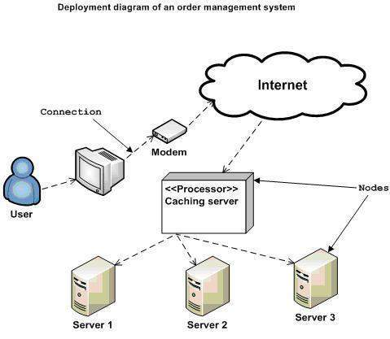
Deployment diagram represents the deployment view of a system. It is related to the component diagram because the components are deployed using the deployment diagrams. A deployment diagram consists of nodes. Nodes are nothing but physical hardware used to deploy the application.

Slide 41
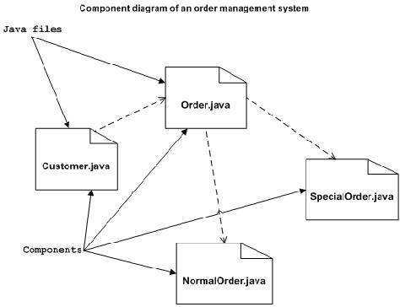
Component diagrams are used to describe the physical artifacts of a system. This artifact includes files, executables, libraries, etc

